Slide 1
Lecture 3 – Cyberethics and Policy management
COM744: Security and Risk Management
Nigel Houlden / Denise Oram
n.houlden@glyndwr.ac.uk / d.oram@Glyndwr.ac.uk

Slide 2
Risk Management?
To sustain a secure environment
A process of identifying factors damaging or disclosing data, mitigating/reducing risk
To develop and implement information security strategies to reduce risk and support the organisational mission and objectives

Slide 3
Considerations
Professionalism – acting to meet the standards set by a profession in terms of individual conduct, competence and integrity
Social responsibility and accountability – a computer professional is a moral individual therefore standards and evidence of transparency and accountability should be maintained
Due diligence – management and execution of due care – a constant

Slide 4
What is ethics/cyber ethics?
Ethics involves the principle of morality
the discipline dealing with what is good and bad and right and wrong
based on our understanding and reasonable thinking with moral duty and obligation
it concerns individual human opinions and beliefs, values and norms that apply to our daily lives
The digital revolution – social & ethical issues can no longer be considered in isolation from the nation and international context

Slide 5
Laws in Cyberspace
Does cyberspace require a new set of laws?
What role does ethics play in regulatory frameworks?
Do the fundamental principles of ethics remain the same in cyberspace?

Slide 6
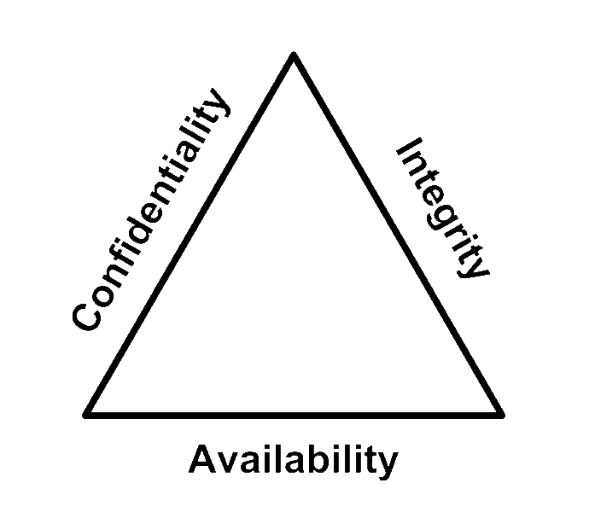
C-I-A Triad
Forms the basis of information security
Confidentiality
Integrity
Availability
Sometimes two other desirable characteristics:
Authentication
Nonrepudiation

Slide 7
C-I-A Triad
Confidentiality
Ensures authorised access to information
Integrity
Provides assurance of accuracy of information processing methods
Availability
Provides timely and reliable access to information to those who have authorised access

Slide 8
Responsibility and Accountability
Organisational security policies
It is everyone’s responsibility
Compliance with security requirements designated by the organisation
Awareness of suspicious activity, security violation and concerns

Slide 9
Security Frameworks
Control Objectives for Information and Related Technologies (COBIT)
A framework for good practice
Enables clear policy development, good practice for IT control and emphasises regulatory compliance

Slide 10
Globalisation and Culture
Laws and regulations relevant to information security differ throughout the world
Awareness of these issues is essential
Many computer crime and information security laws were made some time ago and their relevance today may be questionable.

Slide 11
Challenges
Privacy
Data breaches
Identification of threats and vulnerabilities
Risk assessments
Compliance

Slide 12
Security Policy Management
What is a policy?
A business requirement on actions or processes performed by an organisation
Security policies require placement of controls in processes specific to the system
COBIT 5 (2012) specifically related to information security

Slide 13
Security Policy Management
Standards
Policies
Risk frameworks
Legislation
Guidelines
Codes of practice/conduct
Professional ethics
Codes of ethics – ACM (1)
Enforcement of policies, codes and procedures

Slide 14
Security Policy Management
A perfect world!
Policies and procedures should produce the perfect product
Employees should follow policies and procedures at all time
Business processes need timely information
Good decision making
Control

Slide 15
Security Policy Management Challenges
Creating a perfect world is difficult:
Increasingly complex technologies instigate more vulnerability and disruptions
Reliance on technologies instigates increased vulnerability
The cost of keeping pace with ever-changing technology
Keeping policies up to date
Weakness in failure to keep up to date create weaknesses that make business processes vulnerable to loss/theft
Technical and human challenges facing implementing policies and procedures
Enforcement issues
Understanding the risk
The struggle between government control & individual rights

Slide 16
Best Practice

Slide 17
Cloud Technology
What are the security challenges and any ethical issues?

Slide 18
Current & Future Challenges
AI
IoT/IoE
The landscape of cyberspace is constantly changing
Social media, cyberbullying, terrorist threats
The new ‘cryptowar’

Slide 19
Best Practice

Slide 20
Current & Future Challenges
Easy to publish truthful and valuable information
also then to publish false, libellous information
Cybercrime
Threats to personal privacy
Cyber governance
Free speech censorship
Intellectual property
Potential to cause harm and undermine basic human rights and values
Respect for justice and fairness

Slide 21
What can be done?
Is there a need for a ‘law of cyberspace’?

Slide 22
What can be done?
The Golden Rule?
Should those writing programs - formulate laws to regulate cyberspace rely on ethics as a guide?
“Technology is only a tool and it does not ..determine our destiny ..it is up to us whether this powerful force is used for good or ill purpose”. (2)

Slide 23
Cyber ethics and Culture
Formal Codes of Conduct, Codes of Ethics and organisational policies should assist the practitioner in maintaining professional standards within their work
An individual’s attitudes and values are informed by their cultural, religious, political, and economic circumstances, as well as whatever laws obtain locally
Systems of ethics may be culture-based, globalisation means that requirements need to be determined among individuals subscribing to differing ethical systems. These differences need to be reconciled

Slide 24
What can be done?
Policy groups:
World Wide Web Consortium – an International standards setting body
Internet Engineering Task Force (IETF) – develops technical standards such as communication protocols
“Despite the use of firewalls, security scans, intrusion prevention products and sophisticated encryptions – website continue to be a major target for hackers”. (3)
What can be done for the future?

Slide 25
References
ACM Code of Ethics and Professional Conduct. 2018 “Revision”. Available at: https://www.acm.org/code-of-ethics
Spinello, R. 2017. Cyberethics: Morality and Law in Cyberspace (6th edn). Burlington, MA: Jones and Bartlett Learning.
Spinello, R. 2017. Cyberethics: Morality and Law in Cyberspace (6th edn). Burlington, MA: Jones and Bartlett Learning.

